Slide 1
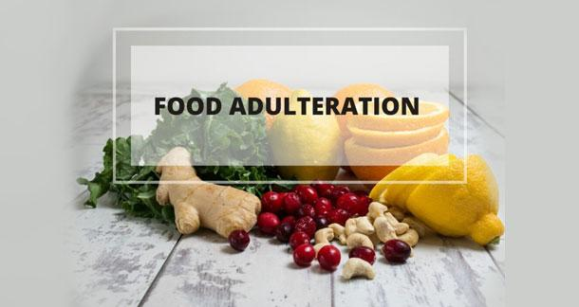
Dr. SHRUTI BAID
MD. NUTRITION AND DIETETICS

Slide 2
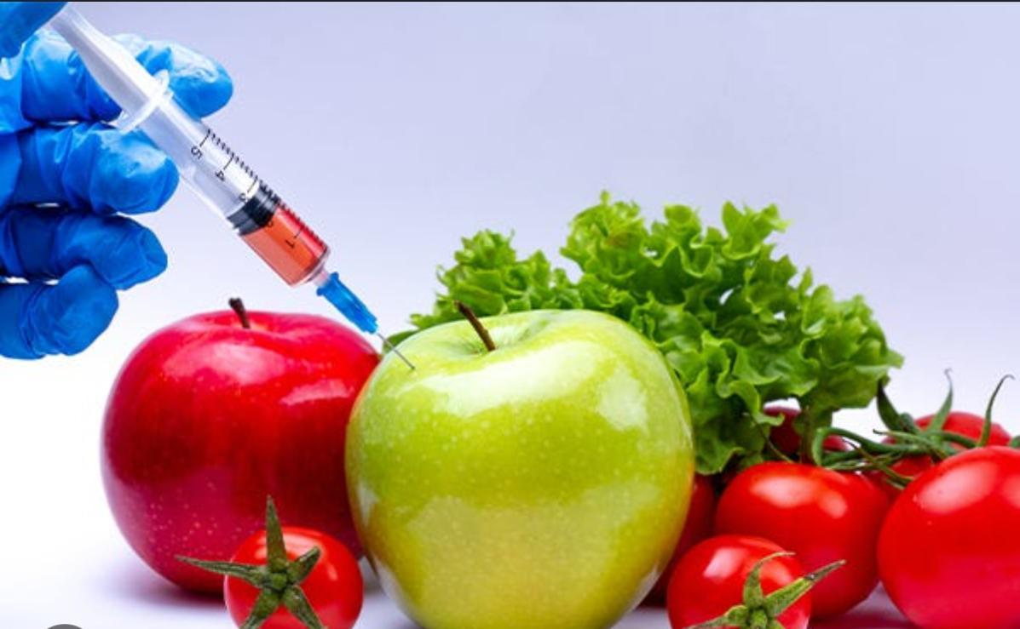
DEFINITION
Adulteration is defined as the process by which the quality or the nature of a given substance is reduced through the addition of a foreign or an inferior substance and the removal of a vital element.

Slide 3
TYPES OF ADULTERANTS
INTENTIONAL - Intentional adulterants are those substances that are added as a deliberate act on the part of the adulterer with the intention to increase the margin of profit.
Eg. sand, marble chips, stones, mud, chalk powder, water, dyes, etc., These adulterants cause harmful effects on the body.
INCIDENTAL - These adulterants are found in food substances due to ignorance, negligence or lack of proper facilities. It is not a willfull act on the part of the adulterer.
Eg. pesticides, droppings of rodents, larvae in food.

Slide 4
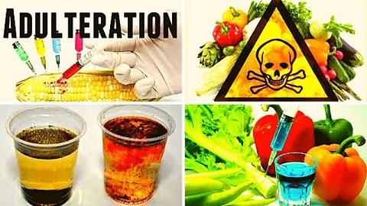
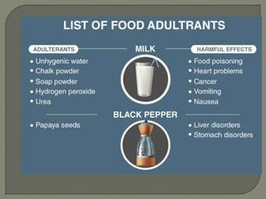
Food and adulterants found in them and their harmful effect

Slide 5
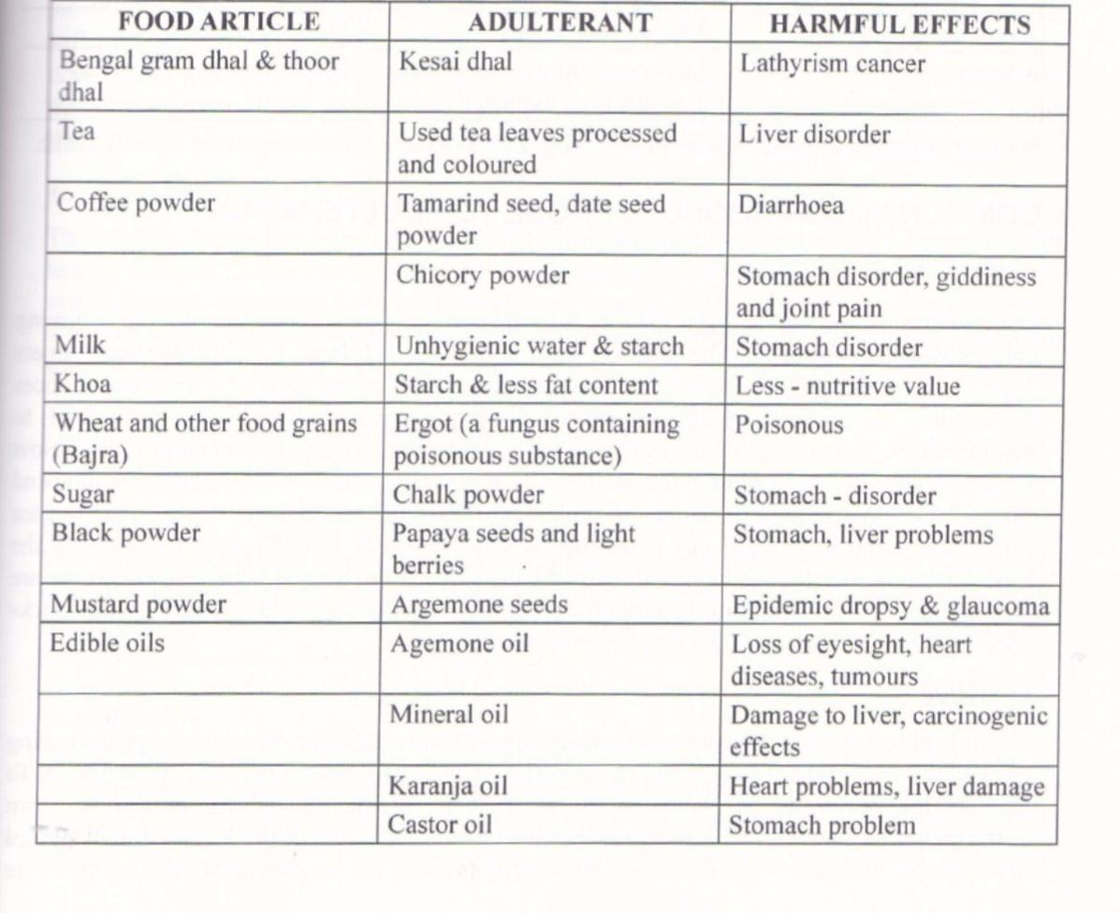

Slide 6
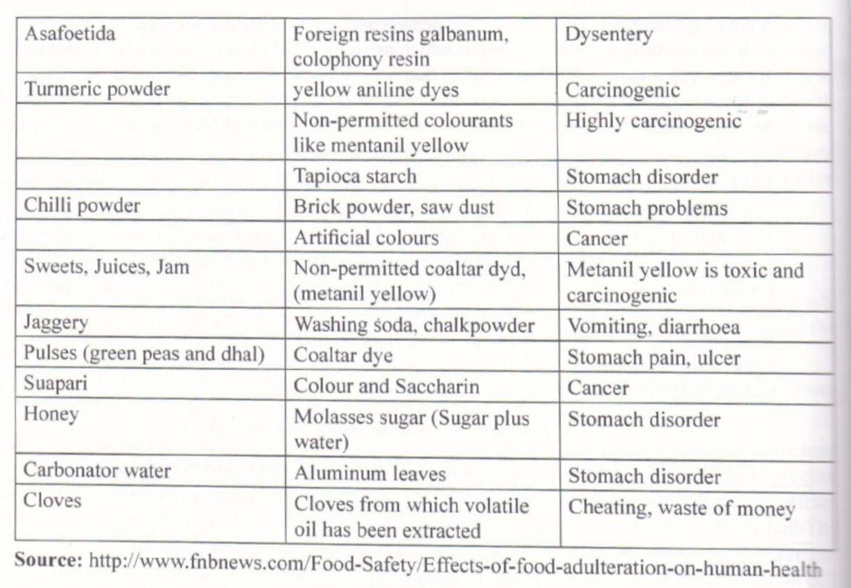

Slide 7
Packaging Hazards:
Plastics such as cellulose acetate, polyamide polyethylene polypropylene and polyvinyl chloride are often used as packing materials because they are light in weight and are resistant to diffusion due to solvents and high temperatures.
However care should be taken that only food grade plastic packing materials should be used for packaging foods to prevent the following packaging hazards.
1. Production of noxious thermal breakdown products which are injurious to health.
2. Formation of toxic residues that result when subjected to heat treatment for sterilization of the contents.
3. Unfavorable reactions between acid and oil content of the food and the packaging material.

Slide 8
FOOD LAWS AND STANDARDS: Prevention of Food Adulteration Act 1954
The prevention of Food Adulteration Act, (PFA) 1954 operated by the Directorate General of Health Services, Ministry of Health was designed for the following purposes :
1. It formulates and monitors the standard of quality and purity of foods with emphasis on prevention of adulteration of foods.
2. It is the basic structure intended to protect the common consumer against the supply of adulterated foods.
3. It makes provision for prevention of adulteration of food and lays down the rule that no person shall manufacture for sale, store, sell or distribute any adulterated or misbranded food or food which contravenes the provision of act or rules.

Slide 9
According to this act, a food is deemed to be adulterated – if:
It is not of the nature, substance and quality, which the food ought to be.
It contains any other substance which affects, or if the article is so processed so as to affect injuriously the nature, substance and quality of the food.
It contains added inferior or cheaper substance that affects the nature and quality of the food.
Any constituent of the food is removed so as to affect injuriously the nature, quality and substance of the food.
It is prepared, packed and stored under unsanitary conditions.
It contains any filthy, disgusting, rotten, decomposed substance of a diseased animal or vegetable substance or is insect-infested or otherwise unfit for human consumption.

Slide 10
The article is obtained from a diseased animal.
The article contains a poisonous ingredient or any other ingredient injurious to health.
The container renders the food injurious to health.
It contains excessive or prohibited colours.
It contains excessive or prohibited preservatives.
It does not satisfy the standards prescribed by the authorities.

Slide 11
Agmark Standard:
The word Agmark is derived from the words ‘ Agricultural Marketing’ . It is a standard of quality based on the physical and chemical characteristics of food, both the natural and those acquired during processing.
Products graded under AGMARK include vegetable oils, ghee, butter, rice, groundnut, pulses and spices. These standards ensure accurate weight and correct selling price.
Bureau of Indian Standards :
The Bureau of Indian Standards lays down criteria for standardization of vegetables and fruit products, spices and condiments, animal products and processed food. Manufacturers are allowed to use the BIS label on each unit of their product, if their products conform with the standards laid down by BIS. The products are checked for quality by laboratories certified by BIS. BIS is also known as ISI (Indian Standard Institution).
Some of the items which require compulsory BIS certification under PFA Act include artificial food colours, natural food colours, food additives, infant formula, milk-cereal based weaning foods, milk powder and condensed milk.

Slide 12



Slide 13
FOOD CONTAMINANTS
Food contaminants are unwanted substances that enter food during production, processing, packaging, storage, or transportation, making the food unsafe or harmful to consume.

Slide 14
Types of Food Contaminants
Biological Contaminants
Examples: Bacteria (Salmonella, E. coli), viruses (Norovirus), parasites (Giardia), fungi (molds).
Sources: Improper hygiene, contaminated water, undercooked food.
Effects: Foodborne illnesses, diarrhea, vomiting, infections.
Chemical Contaminants
Examples:
Pesticide residues (used in agriculture)
Heavy metals (lead, mercury, cadmium)
Food additives (unregulated or excessive use)
Industrial chemicals (dioxins, PCBs)
Sources: Agricultural practices, environmental pollution, improper packaging.
Effects: Cancer risk, hormonal disruption, kidney/liver damage.

Slide 15
Physical Contaminants
Examples: Hair, glass pieces, metal shards, plastic fragments.
Sources: Poor handling during processing/packaging.
Effects: Injuries, choking hazards, consumer distrust.
Allergenic Contaminants
Examples: Traces of nuts, milk, gluten in allergen-free food.
Sources: Cross-contamination in factories.
Effects: Severe allergic reactions (anaphylaxis).

Slide 16
Common Food Contaminants in India
Adulterants: Urea in milk, chalk powder in flour, detergent in paneer.
Pesticides: Found in fruits, vegetables, especially green leafy ones.
Coloring agents: Non-permitted dyes in sweets and snacks.

Slide 17
Prevention and Control
Washing & peeling fruits/vegetables thoroughly.
Cooking food at safe temperatures.
Avoiding open/street food in unhygienic conditions.
Checking FSSAI labels on packaged foods.
Proper food storage – cool, dry, and covered areas.

Slide 18
FOOD ADDITIVES
Food additives are substances intentionally added to food to improve its flavor, appearance, texture, shelf-life, or nutritional value.

Slide 19
Classification of Food Additives A. Based on Function
Type | Purpose | Examples
Preservatives | Prevent spoilage from microbes | Sodium benzoate, potassium sorbate
Coloring Agents | Improve or restore color | Tartrazine (yellow), Caramel
Flavor Enhancers | Improve taste or aroma | Monosodium glutamate (MSG)
Sweeteners | Add sweetness with/without calories | Aspartame, saccharin, stevia
Antioxidants | Prevent oxidation and rancidity | BHA, BHT, Vitamin E (tocopherol)
Emulsifiers | Stabilize mixtures (oil + water) | Lecithin, mono/diglycerides
Thickeners/Stabilizers | Improve texture or consistency | Pectin, guar gum, carrageenan
Acidity Regulators | Maintain pH balance | Citric acid, acetic acid
Nutritional Additives | Improve nutrition | Iron, iodine, Vitamin D

Slide 20
Natural Additives | Synthetic Additives
Obtained from natural sources | Made through chemical processes
E.g., beetroot red, turmeric | E.g., tartrazine, benzoates

Slide 21
Benefits of Food Additives
Prolong shelf life.
Improve food appearance and palatability.
Help in food processing (e.g., anti-caking agents).
Fortify food with essential nutrients

Slide 22
Health Concerns
Allergies: Some additives (like sulfites) may cause allergic reactions.
Hyperactivity: Linked to artificial colors in children (controversial).
Long-term risks: Excessive use of synthetic additives may lead to health issues (e.g., cancer risk, metabolic disturbance).

Slide 23
Common Additives in Indian Foods
Preservatives: Sodium benzoate in juices and jams.
Colours: Permitted dyes in sweets and snacks.
Sweeteners: Sucralose in diet drinks.
Fortification: Iron in atta, iodine in salt.

Slide 24
NATURAL TOXINS
Natural toxins are poisonous substances that occur naturally in certain foods. They are not added by humans but are produced by plants, animals, or microorganisms as defense mechanisms or due to environmental conditions.

Slide 25
Source | Toxin | Examples of Food | Health Effects
Plants | Glycoalkaloids (solanine) | Green potatoes, sprouted potatoes | Nausea, vomiting, nervous system issues
 | Cyanogenic glycosides | Bitter almonds, cassava, apple seeds | Release cyanide – can be fatal
 | Lectins | Raw kidney beans | Nausea, vomiting, diarrhea
 | Myristicin, safrole | Nutmeg (excess), betel nut | Hallucinations, liver toxicity
Fungi | Mycotoxins (aflatoxins) | Moldy grains, nuts, spices | Liver cancer, immune suppression
Seafood | Histamine, ciguatoxin | Spoiled fish, reef fish (e.g., barracuda) | Allergic-like reactions, neurotoxic effects
Animals | Tetrodotoxin | Pufferfish (fugu) | Paralysis, potentially fatal

Slide 26
Factors Influencing Toxin Levels
Improper storage (moisture → mold growth)
Immature or sprouting crops
Inadequate cooking
Contaminated water or environment

Slide 27
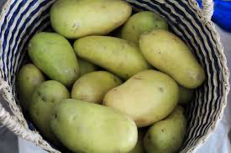
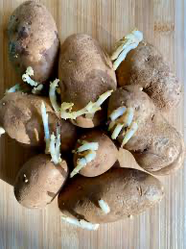
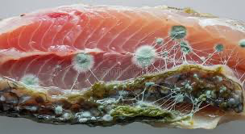
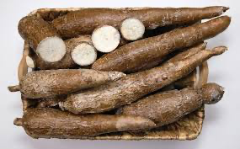
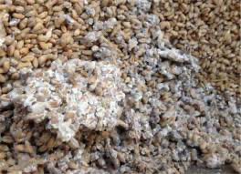

Slide 28
Methods to Reduce Risk
Proper cooking: Boiling destroys lectins in beans.
Avoid spoiled or mouldy food: Prevents mycotoxin exposure.
Peel green/sprouted potatoes: Reduces solanine.
Soaking and fermenting: Reduces cyanide in cassava.
Regulated sourcing: Especially for seafood and spices.

Slide 29
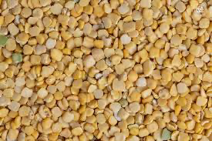
Common Examples in India
Food | Toxin | Precaution
Lathyrus sativus (Kesari dal) | ODAP neurotoxin | Limit intake to avoid lathyrism
Groundnuts, maize | Aflatoxins | Store in dry, cool place
Cassava (tapioca) | Cyanogenic glycosides | Soak, boil properly before consumption
Mustard seeds (excess) | Erucic acid | Use in moderation

Slide 30
FOOD FORTIFICATION
Food fortification is the practice of deliberately increasing the content of essential micronutrients—such as vitamins and minerals—in food to improve the nutritional quality of the food supply and provide a public health benefit.

Slide 31
Objectives of Food Fortification
• Prevent and control micronutrient deficiencies.
• Improve public health and nutritional status.
• Provide essential nutrients through commonly consumed foods.
• Support cognitive and physical development, especially in children.
• Reduce the burden of diseases linked to deficiencies (e.g., anemia, rickets).

Slide 32
Types of Food Fortification
1. Mass Fortification – Added to foods consumed by the general population (e.g., salt with iodine).
2. Targeted Fortification – For specific population groups (e.g., biscuits with iron for school children).
3. Market-Driven Fortification – Voluntarily added by manufacturers (e.g., breakfast cereals with B-vitamins).

Slide 33
Commonly Fortified Foods and Nutrients
• Salt – Iodine (to prevent goiter)
• Milk – Vitamin D and A
• Flour – Iron, Folic Acid, B-vitamins
• Oil – Vitamin A and D
• Rice – Iron, Zinc, Folic Acid, Vitamin B12

Slide 34
Advantages of Food Fortification
• Cost-effective public health intervention.
• Does not require changes in eating habits.
• Wide population coverage.
• Quick improvement in nutritional status.
• No need for individual compliance.

Slide 35
Limitations of Food Fortification
• May not reach the poorest who lack access to processed foods.
• Risk of excessive intake if not monitored.
• Limited to foods that are widely consumed.
• Does not address root causes of malnutrition (e.g., poverty, poor sanitation).

